Slide 1



Automating Verification of Cyber-Physical Systems with HyST (A Source Transformation and Translation Tool for Hybrid Automaton Models)
DISTRIBUTION A. Approved for public release. Distribution unlimited. (Approval AFRL PA #88ABW-2015-1758, 07 Apr 2015)
Stanley Bak, Sergiy Bogomolov, Taylor T. Johnson
Contributors: Christian Schilling, Luan Viet Nguyen, Hoang-Dung Tran
VeriVITAL - The Verification and Validation for Intelligent and Trustworthy Autonomy Laboratory (http://verivital.uta.edu/)
Department of Computer Science and Engineering
1
2
3
4
3
3
1
2
3
4
[Bak, Bogomolov, and Johnson, HSCC 2015]

Slide 2
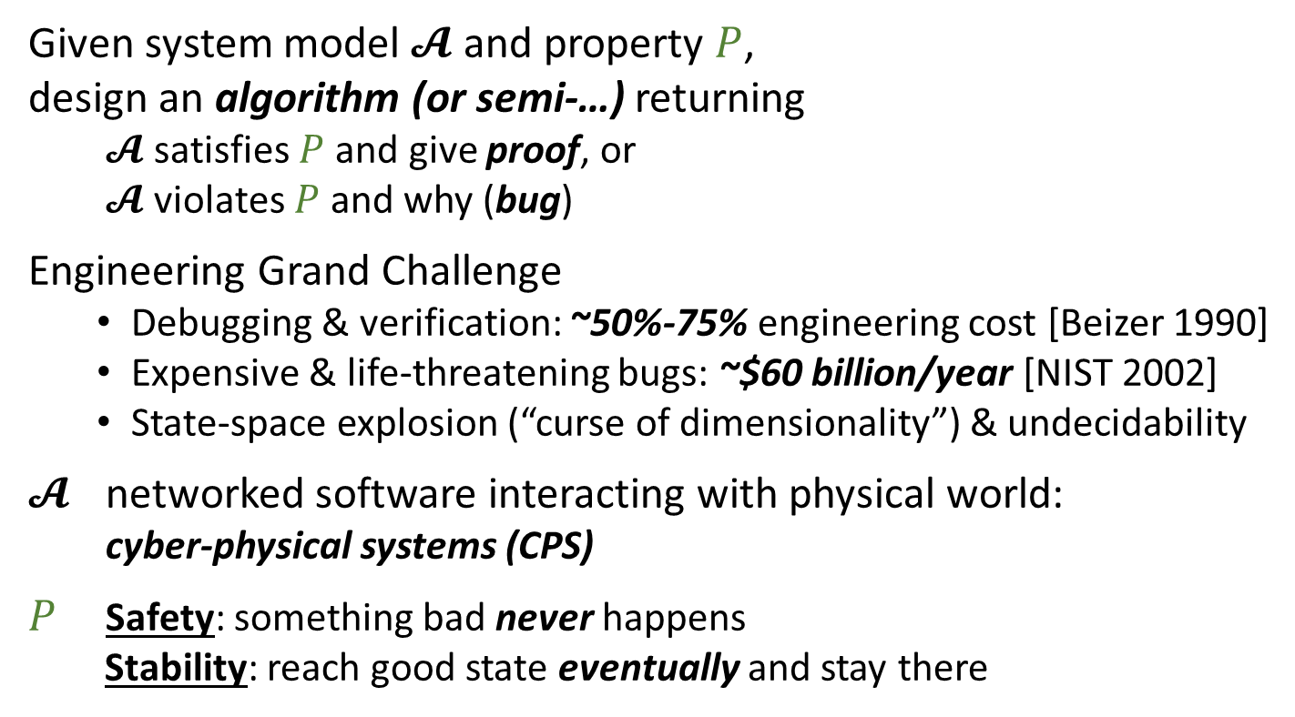
Verification Challenge
$$𝓐, P$$
Given system model $𝓐$ and property $P$,
design an algorithm (or semi-…) returning
$𝓐$ satisfies $P$ and give proof, or
$𝓐$ violates $P$ and why (bug)
Engineering Grand Challenge
Debugging & verification: ~50%-75% engineering cost [Beizer 1990]
Expensive & life-threatening bugs: ~$60 billion/year [NIST 2002]
State-space explosion (“curse of dimensionality”) & undecidability
$𝓐$ networked software interacting with physical world:
cyber-physical systems (CPS)
$P$ Safety: something bad never happens
Stability: reach good state eventually and stay there
$$𝓐⊨P?$$
No: bug
Yes: proof

Slide 3
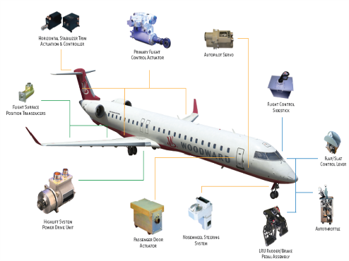
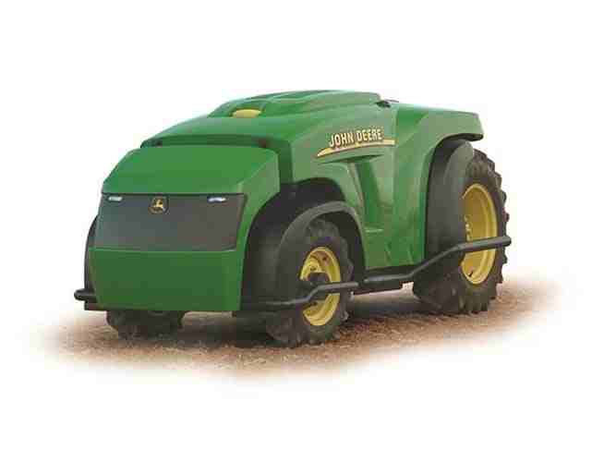
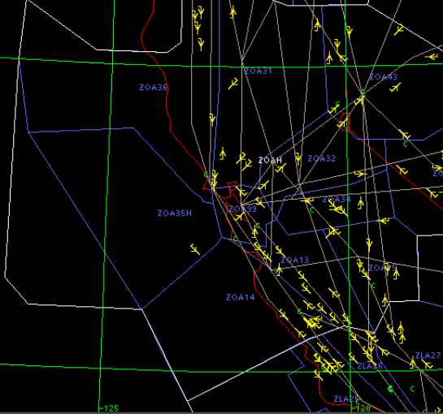
Research Direction Goals
General Area: Formal verification of cyber-physical systems (systems with both discrete behaviors) using Hybrid Automata and Hybrid I/O Automata
There's no single best way to do analysis. Many techniques may need to be used depending on the problem.
Fault-Tolerant
Power Distribution
Autonomous Vehicles
Air Traffic Control
Notes:
3

Slide 4
todos
AIDE-CPS
Show soundness bugs, semantics mismatches
Mention random generation
Show graphic for correct by construction plant + controller
Hyst passes
SLSF integration and examples
Network translation and composition Hypy Luts Benchmark generators Other groups adding tool support Starl integration Reach set parsing, output format standardization Llvm or smt for hybrid systems Aidecps
Passel 2.0: annotations and parameterizations
Other groups adding support: C2e2 Keynaerax Ksu Rajarshi Maybe you or your group!

Slide 5



HyST: A Source Transformation and Translation Tool for Hybrid Automaton Models
$$H$$
SpaceEx XML
NOTE: SpaceEx grammar is NOT restricted to affine (linear) functions, although SpaceEx’s current reachability algorithms are
$$P$$
Source-to-source transformation passes (IR to IR), such as abstractions
HyST Intermediate Representation (IR)
(Networks of hybrid automata)
Matlab, Python, and Java APIs
HyRG
(Hybrid Random Generator) http://verivital.com/hyrg/
Semantics Preserving Translation
Random Generation
(+ Other benchmark generators)
Simulink/ Stateflow
dReach
Flow*
HyCreate
HyComp
(nuXmv)
QBMC
(Z3py)
SMT-LIB
…
(YOUR TOOL)
http://verivital.uta.edu/hyst/
[Bak, Bogomolov, Johnson, HSCC 2015]
Notes:
QBMC: Quantified bounded model checking for rectangular Hybrid Automata

Slide 6
HyST: History of Hybrid Systems Verification Tools
HSIF: Hybrid Systems Interchange Format [Pinto et al, HSCC 2005], outcome of DARPA MoBIES and other projects (Charon, d/dt, HyTech, Checkmate, …)
CIF: Compositional Interchange Format for Hybrid Systems [van Beek et al, HSCC 2007]
Libraries for parsers even available! http://cif.se.wtb.tue.nl/
Problems with common formats (as usual):
Possible semantics differences and edge cases (see UML, Statecharts, C, …); may vs. must, urgency vs. not, …
Laziness, funding motivations, paper writing (“new” tools), etc.
Existing interchange formats not known to many or forgotten (very unfortunate)
Other options: Simulink/Stateflow, Modelica, Ptolemy, some AADL variants (UML), ...
Recent research status and tools
Flow*, dReach, SpaceEx, HyCreate, C2E2, probably many other tools use hybrid automata
Same semantics (hybrid automata and executions thereof), but different syntax!
In my view, worst possible scenario
Poor graduate students (e.g., recently me) have to translate by hand examples between tools for papers
Or, ambitious ones hack scripts to translate from one tool to another (e.g., in Passel…)
All of this can be done (nicely) within HyST, and reduces the chances for bugs (extensive unit/regression testing framework setup)
Some approaches, e.g., parameterized networks in Passel (and many different semantics for networks in general) or stochastic hybrid systems, require more general semantics, but most recent approaches target hybrid automata, and work is underway
Exceptions are most recent theorem-proving approaches (in PVS, Isabelle, and KeyMaera) due to expressiveness

Slide 7
HyST Vision
“SMT-LIB” or “llvm” for hybrid systems
Short-term: implementation framework for source-to-source translation, benchmark generators, etc.
Find and fix bugs (especially soundness ones) in CPS development tools (NSF CCF/SHF AIDE-CPS project)
Midterm vision: Output interchange formats: common reachable set representations and comparisons
Longer-term vision: objective comparisons between algorithms, data structures, symbolic state representations, etc., so we can get to the status in verification of continuous/hybrid systems where we are at in numerical analysis/simulation of such systems (e.g., see Simulink/Stateflow) and hardware verification (e.g., Cadence/Synopsys)

Slide 8
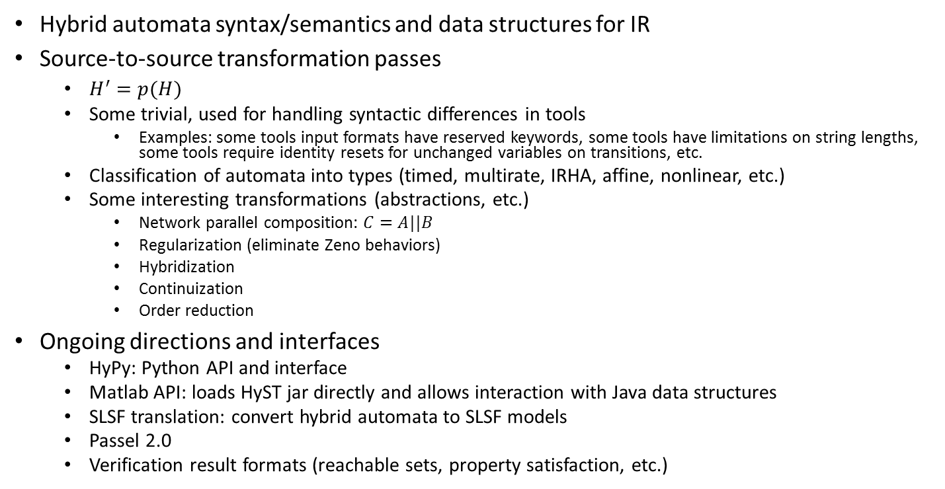
HyST Overview and Outline for Remainder
Hybrid automata syntax/semantics and data structures for IR
Source-to-source transformation passes
$H^{′}=p(H)$
Some trivial, used for handling syntactic differences in tools
Examples: some tools input formats have reserved keywords, some tools have limitations on string lengths, some tools require identity resets for unchanged variables on transitions, etc.
Classification of automata into types (timed, multirate, IRHA, affine, nonlinear, etc.)
Some interesting transformations (abstractions, etc.)
Network parallel composition: $C=A||B$
Regularization (eliminate Zeno behaviors)
Hybridization
Continuization
Order reduction
Ongoing directions and interfaces
HyPy: Python API and interface
Matlab API: loads HyST jar directly and allows interaction with Java data structures
SLSF translation: convert hybrid automata to SLSF models
Passel 2.0
Verification result formats (reachable sets, property satisfaction, etc.)

Slide 9
Hybrid Automata: Syntax, Semantics, and Data Structures for Intermediate Representation (IR)

Slide 10
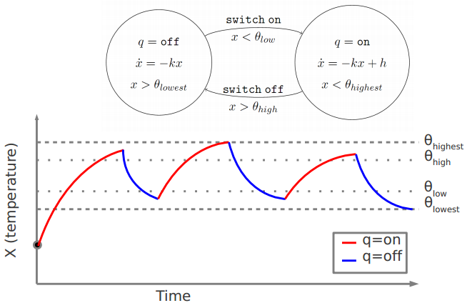
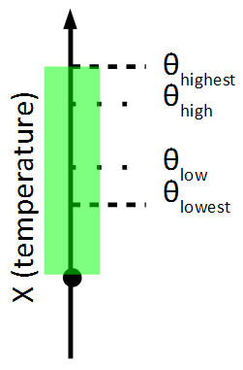
Hybrid Systems and Hybrid Automata
Model for mixed continuous/discrete behaviors
Simulation
Reachability

Slide 11
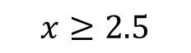
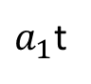
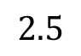
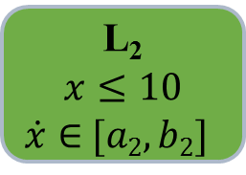
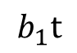
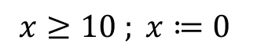
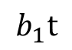
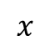
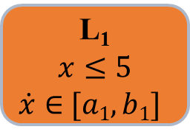
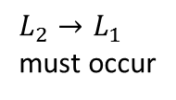
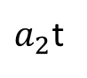
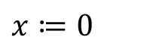
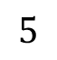
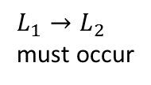
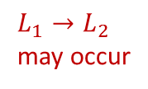
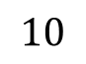
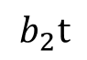
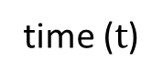
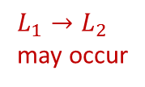
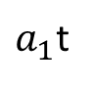
Hybrid Automaton Example
$$x≥2.5$$
$$x≔\text{0}$$
L₁
$$x≤5$$
$\dot{x}∈$ $[a1,b1]$
L₂
$$x≤10$$
$\dot{x}∈$ $[a2,b2]$
$L_{1}→L_{2}$
may occur
$L_{1}→L_{2}$
must occur
$$x≥10 ; x≔\text{0}$$
$$x$$
$L_{2}→L_{1}$
must occur
$L_{1}→L_{2}$
may occur
$$10$$
$$b_{2}t$$
$$5$$
$a_{2}$t
$$2.5$$
$$b_{1}t$$
$$b_{1}t$$
$a_{1}$t
$a_{1}$t
time ($t$)

Slide 12
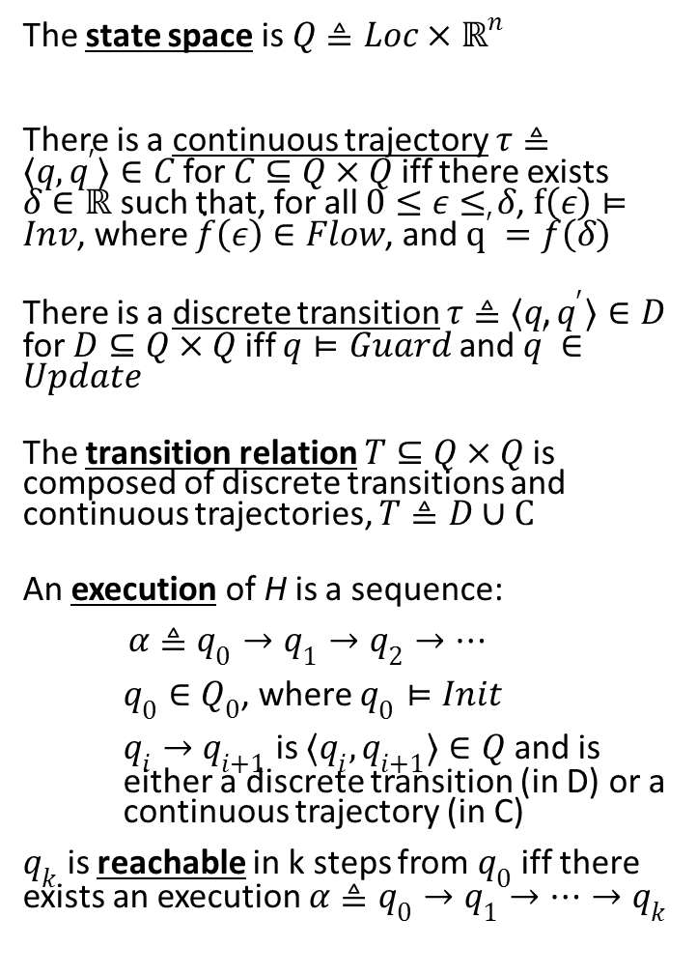
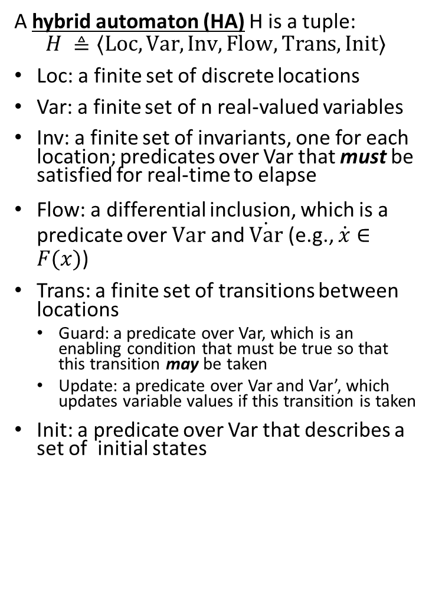
Hybrid Automata: Syntax and Semantics
A hybrid automaton (HA) H is a tuple:
$$H ≜〈Loc, Var, Inv, Flow, Trans, Init〉$$
Loc: a finite set of discrete locations
Var: a finite set of n real-valued variables
Inv: a finite set of invariants, one for each location; predicates over Var that must be satisfied for real-time to elapse
Flow: a differential inclusion, which is a predicate over $Var$ and $\dot{Var}$ (e.g., $\dot{x}∈F(x)$)
Trans: a finite set of transitions between locations
Guard: a predicate over Var, which is an enabling condition that must be true so that this transition may be taken
Update: a predicate over Var and Var’, which updates variable values if this transition is taken
Init: a predicate over Var that describes a set of initial states
The state space is $Q≜Loc×ℝ^{n}$
There is a continuous trajectory $τ≜〈q,q^{′}〉∈C$ for $C⊆Q×Q$ iff there exists $δ∈ℝ$ such that, for all $0≤ε≤δ$, $f\left(ε\right)⊨Inv$, where $\dot{f}\left(ε\right)∈Flow$, and $q^{′}=f\left(δ\right)$
There is a discrete transition $τ≜〈q,q^{′}〉∈D$ for $D⊆Q×Q$ iff $q⊨Guard$ and $q^{′}∈Update$
The transition relation $T⊆Q×Q$ is composed of discrete transitions and continuous trajectories, $T≜D∪C$
An execution of H is a sequence:
$α≜q_{0}→q_{1}→q_{2}→…$
$q_{0}∈$ $Q_{0}$, where $q_{0}⊨Init$
$q_{i}→q_{i+1}$ is $〈q_{i},q_{i+1}〉∈Q$ and is either a discrete transition (in D) or a continuous trajectory (in C)
$q_{k}$ is reachable in k steps from $q_{0}$ iff there exists an execution $α≜q_{0}→q_{1}→…→q_{k}$

Slide 13
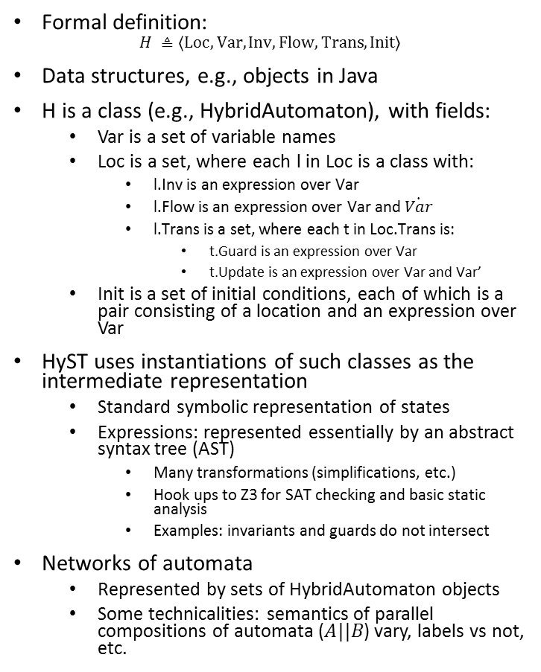
Data Structures for Hybrid Automata
public abstract class Component
public ArrayList <String> variables = new ArrayList <String>();
…
}
public class BaseComponent extends Component {
public LinkedHashMap <String, AutomatonMode> modes = new LinkedHashMap <String, AutomatonMode>();
public ArrayList <AutomatonTransition> transitions = new ArrayList<AutomatonTransition>();
…
}
public class AutomatonMode {
public Expression invariant;
public LinkedHashMap <String, ExpressionInterval> flowDynamics;
…
}
Formal definition:
$$H ≜〈Loc, Var, Inv, Flow, Trans, Init〉$$
Data structures, e.g., objects in Java
H is a class (e.g., HybridAutomaton), with fields:
Var is a set of variable names
Loc is a set, where each l in Loc is a class with:
l.Inv is an expression over Var
l.Flow is an expression over Var and $\dot{Var}$
l.Trans is a set, where each t in Loc.Trans is:
t.Guard is an expression over Var
t.Update is an expression over Var and Var’
Init is a set of initial conditions, each of which is a pair consisting of a location and an expression over Var
HyST uses instantiations of such classes as the intermediate representation
Standard symbolic representation of states
Expressions: represented essentially by an abstract syntax tree (AST)
Many transformations (simplifications, etc.)
Hook ups to Z3 for SAT checking and basic static analysis
Examples: invariants and guards do not intersect
Networks of automata
Represented by sets of HybridAutomaton objects
Some technicalities: semantics of parallel compositions of automata ($A||B$) vary, labels vs not, etc.

Slide 14
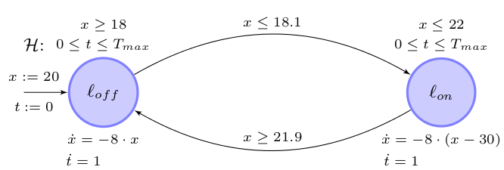
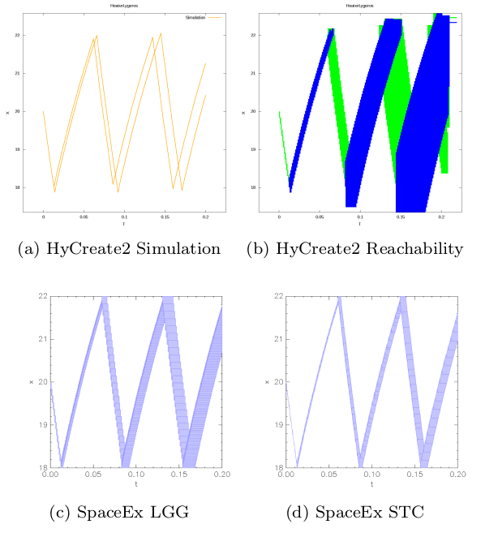
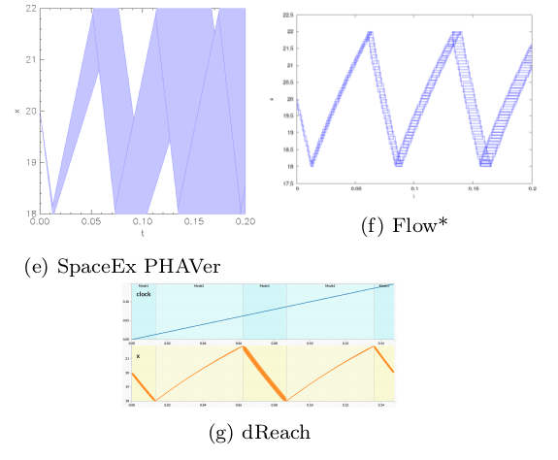
Comparing Verification Tools with Hyst

Slide 15
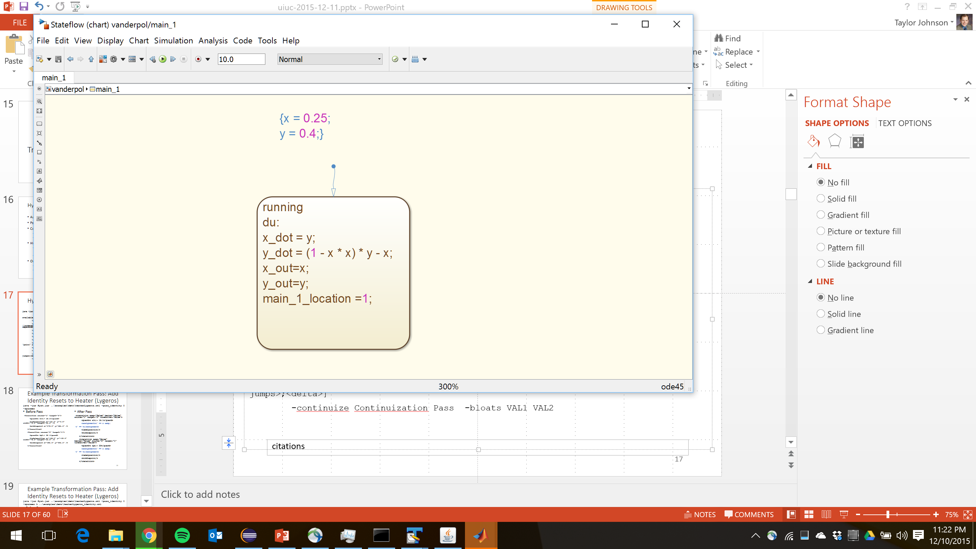
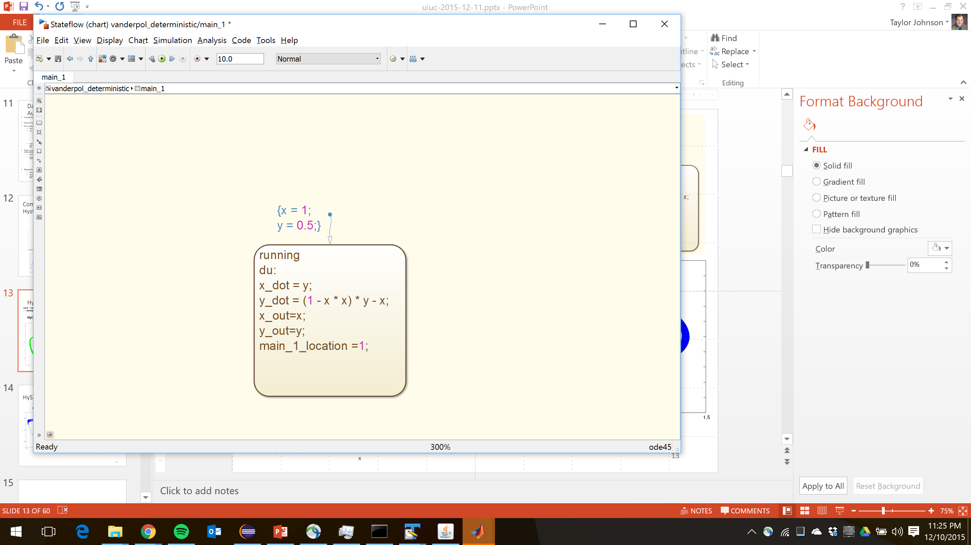
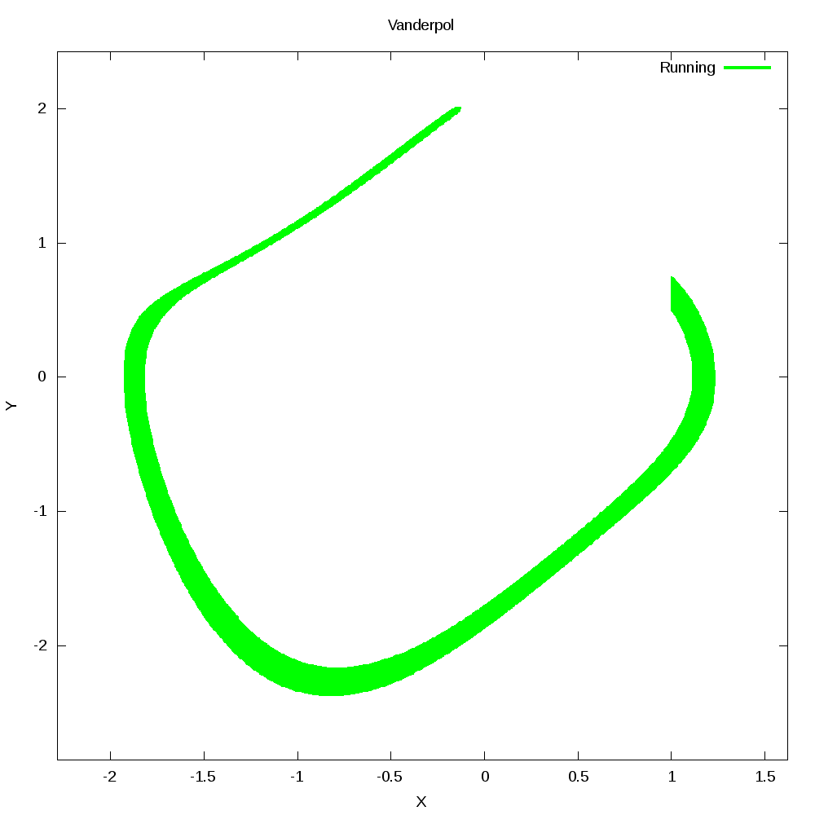
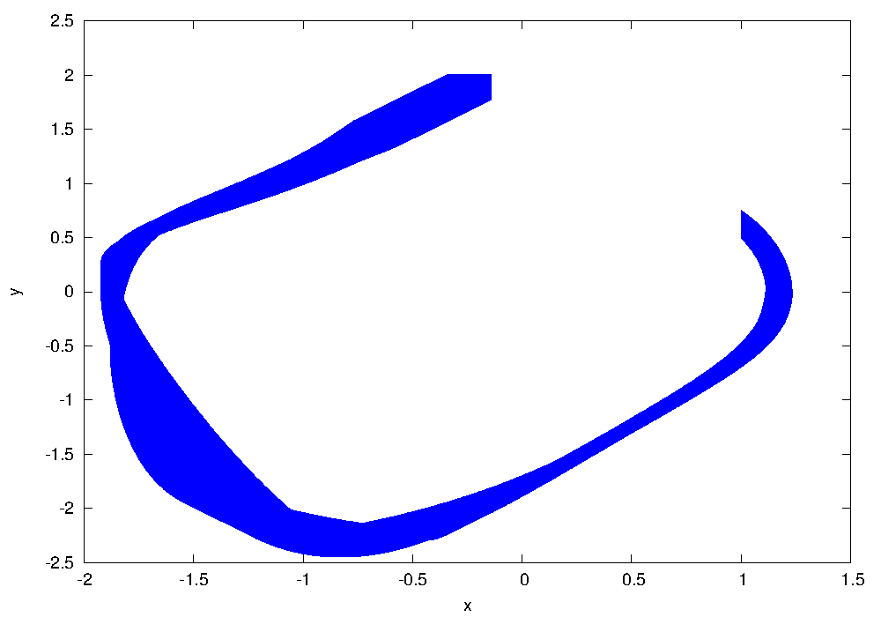
HyST Van Der Pol Example
java -jar Hyst.jar ..\examples\demo\vanderpol_deterministic.xml -stateflow
HyCreate
Flow*

Slide 16
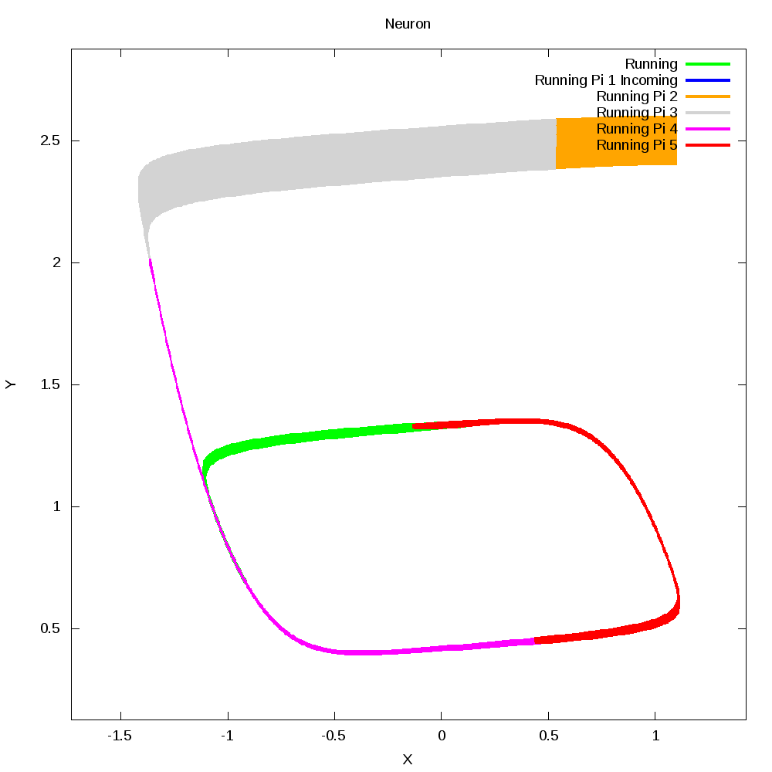
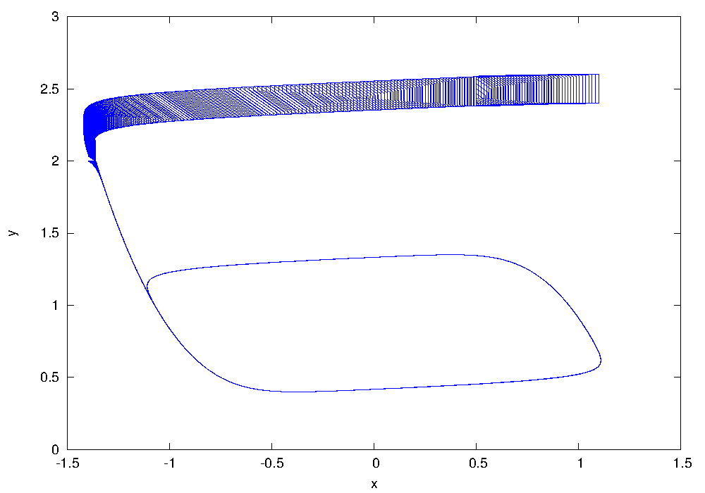
HyST Neuron Example
Flow*
HyCreate with Pseudo-Invariants

Slide 17
Transformation Passes

Slide 18
HyST Model Transformation Passes
Automated abstractions
Pseudo invariants
Continuzation
Abstract a hybrid automaton with a purely continuous system
[Bak and Johnson, RTSS 2015]
Hybridization
Abstract nonlinear dynamics with a hybrid automaton with linear dynamics
[Bak, Bogomolov, Henzinger, Johnson, Prakash (in review)]
http://verivital.com/hyst/pass-hybridization/
Order reduction
Reduce dimensionality of a hybrid automaton
[Tran, Nguyen, Xiang, Johnson (in review)]
http://verivital.com/hyst/pass-order-reduction/

Slide 19
HyST User Interaction for Passes
java -jar Hyst.jar -h
Available Model Transformation Passes:
-pass_identity Add Identity Resets Pass [no param]
-pass_pi Pseudo-Invariant at Point Pass [(modename|)pt1;inv_dir1|pt2;inv_dir2|...] (point/invariant direction is a comma-separated list of reals)
-pass_pi_sim Pseudo-Invariant Simulation Pass [time1;time2;...]
-pass_scale_time Scale Time Pass [multiplier;ignorevar]
-pass_sub_constants Substitute Named Constants for Values Pass [no param]
-pass_simplify Simplify Expressions Pass [no param]
-pass_split_disjunctions (print) Split Guards with Disjunctions if the param 'print' is given, any disjunctions that are split will be printed.
-pass_remove_unsat Remove Unsatisfiable Modes Pass [no param]
-shorten Shorten Mode Names Pass [no param]
-regularize Regularization (eliminate zeno behaviors) Pass [<num jumps>;<delta>]
-continuize Continuization Pass -bloats VAL1 VAL2

Slide 20
Example Transformation Pass: Add Identity Resets to Heater (Lygeros)
java -jar Hyst.jar ..\examples\demo\heaterLygeros.xml -pass_identity 0 -spaceex
Before Pass
<transition source="1" target="2">
<guard>x &lt;= 18.1</guard>
<labelposition x="-31.0" y="3.0" width="76.0" height="50.0" />
<middlepoint x="579.0" y="381.5" />
</transition>
<transition source="2" target="1">
<guard>x &gt;= 29 </guard>
<labelposition x="-38.0" y="-52.0" width="78.0" height="50.0" />
<middlepoint x="591.0" y="261.5" />
</transition>
After Pass
<transition asap="false" bezier="false" source="1" target="2" timedriven="false">
<guard>x &lt;= 18.1</guard>
<assignment>x' == x &amp;
t' == t</assignment>
<labelposition/>
<middlepoint/>
</transition>
<transition asap="false" bezier="false" source="2" target="1" timedriven="false">
<guard>x &gt;= 29</guard>
<assignment>x' == x &amp;
t' == t</assignment>
<labelposition/>
<middlepoint/>
</transition>

Slide 21
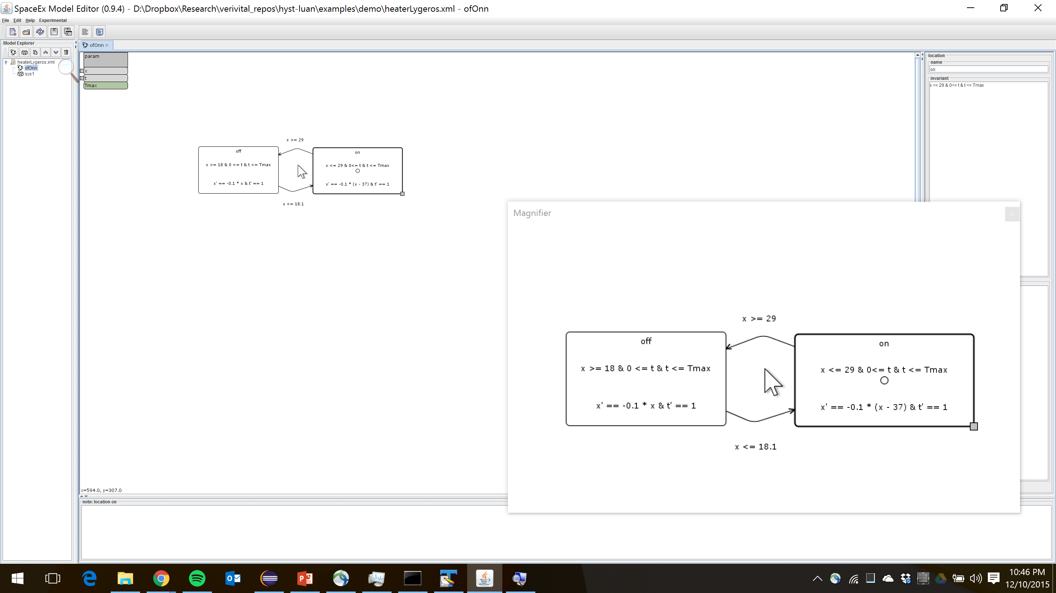
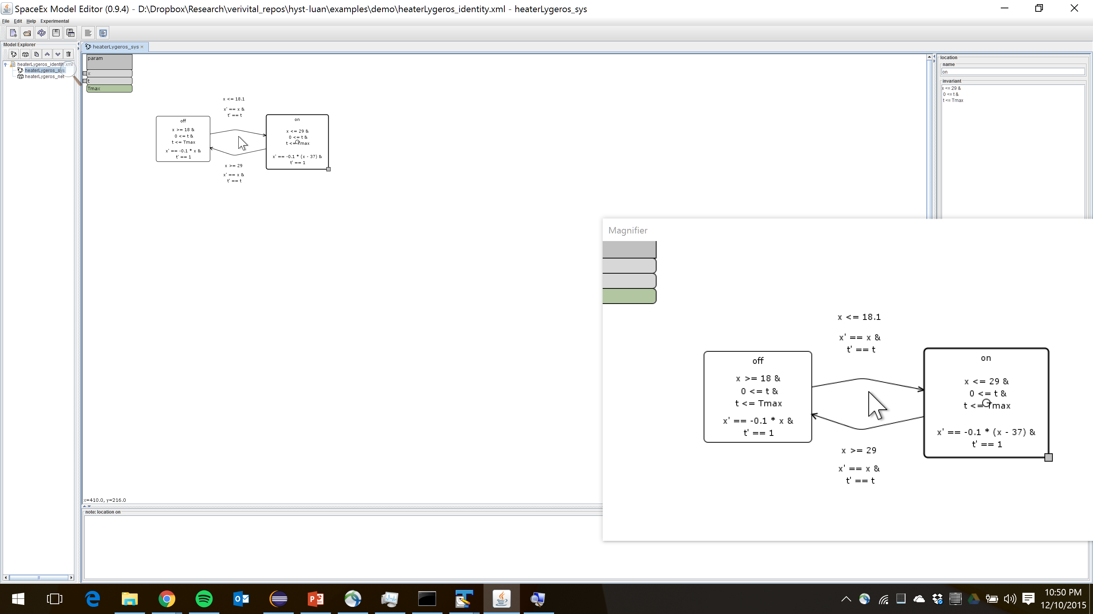
Example Transformation Pass: Add Identity Resets to Heater (Lygeros)
java -jar Hyst.jar ..\examples\demo\heaterLygeros.xml -pass_identity 0 -spaceex > ..\examples\demo\heaterLygeros_identity.xml
Before Pass
After Pass

Slide 22
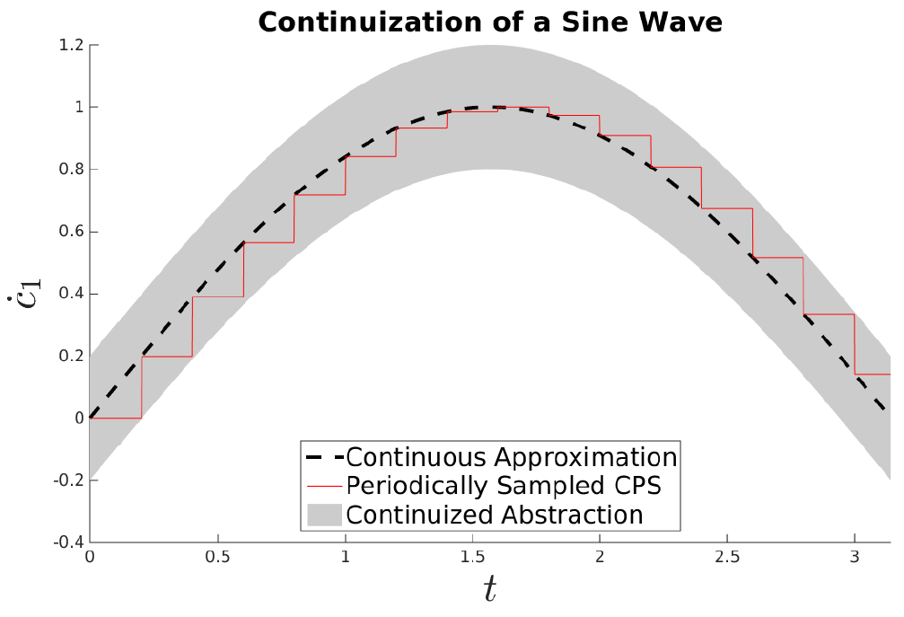
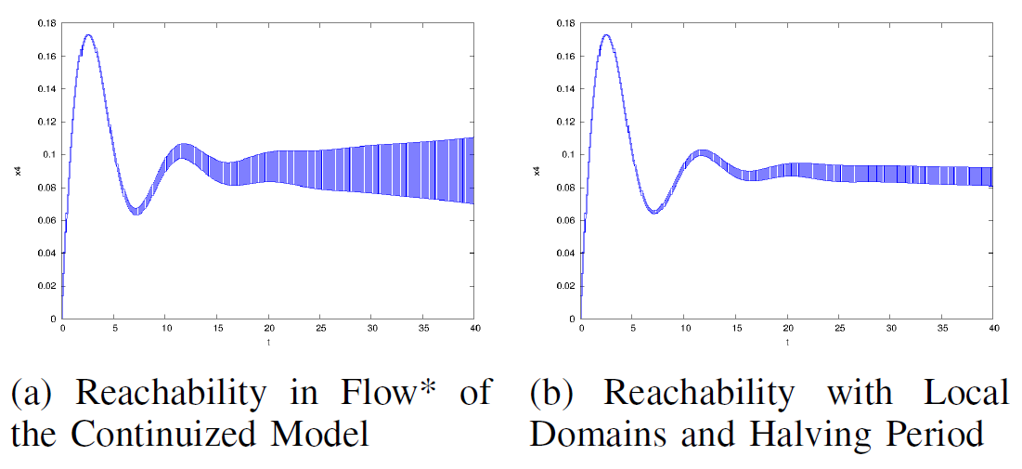
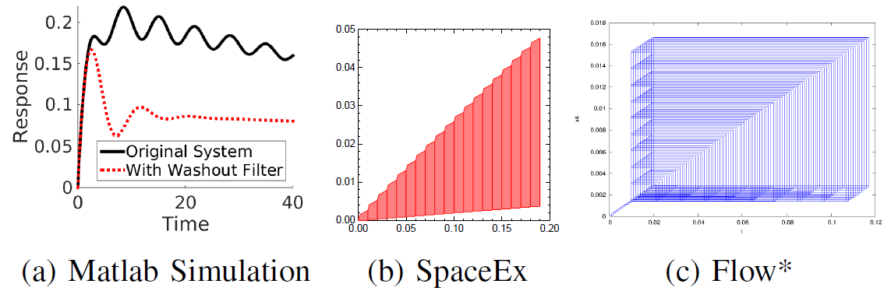
Continuization Pass

Slide 23
Continuization
Approximate a quickly-switching discrete system by a continuous system with bounded noise (nondeterminism)
Previously used to analyze properties about hardware circuits (phase-locked loops)
Key challenge: how much nondeterminism?
“Formal Verification of Phase-Locked Loops using Reachability Analysis and Continuization”, Althoff et al., CACM 2013

Slide 24
Verification
Reachability is important for verification
Reachable
States
Initial
States
Unsafe
States

Slide 25
Verification
Reachability accuracy is important for verification
Reachable
States
Initial
States
Unsafe
States
Overapproximation of
Reachable States

Slide 26
Verification
Reachability accuracy is important for verification
Reachable
States
Initial
States
Unsafe
States
Overapproximation of
Reachable States

Slide 27
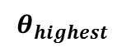
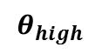
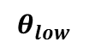
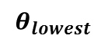
Flowpipe Construction
Flowpipe construction explores the reachable states symbolically
Continuous Post
Discrete Post
X (temperature)
Post_{C}
Post_{C}
Post_{C}
Post_{C}
…
Intersection
Intersection
Intersection
Computation Steps

Slide 28
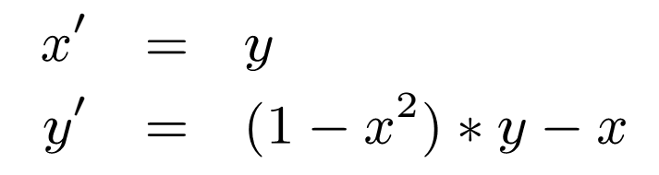
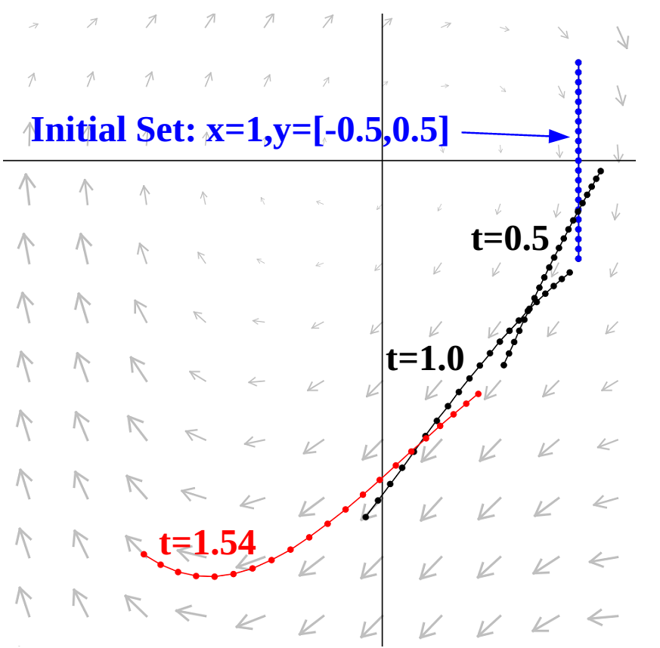
Continuous Post
Track sets of states at different instants in time
Continuous Post Operation

Slide 29
Intersection
Tracked states get overapproximated when performing intersection operations
Typically adds some error
Overapproximation for Intersection

Slide 30


Periodic Control System Models
Apply a digital controller to a physical system
Depending on the implementation, different hybrid automaton representation
Strictly Periodic
Real-time Scheduled*

Slide 31
Periodic Control System Reachability
Reachability tools experience error on each discrete transition
Periodic control systems have lots of discrete transitions
Controller may run tens or hundreds of times per second

Slide 32

Example
Simple 1-d system: point moving along a line
x’= vel vel’ = accel (accel set by PD-controller)
Controlled at 200 Hz (T=0.005)
Reachability from x=[0,0.1]
“SpaceEx: Scalable Verification of Hybrid Systems ”, Frehse et al., CAV 2011
“Flow*: An Analyzer for Non-Linear Hybrid Systems”, Chen et al., CAV 2013

Slide 33
Continuization of a Sine Wave
controller_update(t) = sin(t)
t in [0, π]
Controller period, T = 0.2

Slide 34
Process for Sine Wave Example
Derivative of sin(t) is cos(t)
Bound on cos(t) from 0 to π is K=[-1, 1]
Maximum deviation is [-T, 0] * K = [-0.2, 0] * [-1, 1] = [-0.2, 0.2]

Slide 35

Local Analysis Domains - Example
Bound in each domain is [-T, 0] * K_{i}
Domains overlap by T = 0.2 (why?)

Slide 36
Observations
Accuracy can be improved either through local analysis domains, or by considering smaller periods (multiply by [-T, 0])
Contrast with reachability of direct models
Intuitively, sampling at a higher frequency more closely matches the continuous system
Trade-off of analysis domains versus number of discrete transitions (time-triggered support)
The continuized system also accounts for variations from real-time scheduling

Slide 37

Point-Line Example

Slide 38
Finding K
Process is :
(1) symbolic derivative
(2) compute bounds K in each domain
(3) multiply [-T, 0] * K
Step (2) can be tricky, since if the domain is wrong, the bounds will be wrong.

Slide 39
Derivative Range
To compute the range of the derivative, you might need to know the range of the derivative
Chicken and egg problem
Example: In the point-line system, the continuous approximation has:
a' = -10*v – 3 * a
Question: In time [0,10], what is the range of a'?

Slide 40
Range Checks
Solution: guess and check
Assume the real range is close to the simulated range (add bloating term)
Add reachability-time checks if the ranges are wrong to error modes
If no error modes are reached, then the ranges are correct

Slide 41
Hyst Implementation
Continuization was implemented in the Hyst model transformation tool. Input is:
Hybrid Automaton Model Description File
Maximum Controller Inter-Sample Time, T
Periodically-Controlled Variable Name
Times for Analysis Domains
Bloating Terms for Analysis Domains
Time Variable Name (optional)

Slide 42

Yaw-Damper for a 747 Aircraft
Case study from Matlab control systems toolbox
LTI dynamics, MIMO system
2 inputs (rudder, aileron); 2 outputs (yaw rate, bank angle); 5 internal states (sideslip angle, yaw rate, roll rate, bank angle, and washout filter variable)
Control goal: prevent oscillations while maintaining spiral mode in aileron-to-bank angle impulse response
“Yaw Damper Design for a 747® Jet Aircraft” http://www.mathworks.com/help/control/examples/yaw-damper-design-for-a-747-jet-aircraft.html

Slide 43


Yaw-Damper Direct Reachability
The spiral mode is the apparent offset in the steady-state in the aileron-to-bank angle impulse response
We analyze a real-time scheduled periodic version of this model running at T=0.05 (20Hz)

Slide 44

Yaw-Damper with Continuization

Slide 45

Hybridization

Slide 46


Another Model Transformation: Pseudo-Invariants
Pseudo-invariants improve reachability computation by splitting a mode in a hybrid automaton
converted to
"Reducing the Wrapping Effect in Flowpipe Construction using Pseudo-Invariants (Work-in-Progress)", S. Bak, Fourth Workshop on Design, Modeling and Evaluation of Cyber Physical Systems (CyPhy 2014)
Notes:
46

Slide 47

Van der Pol Dynamics
Notes:
47

Slide 48
Flow-pipe computation
Notes:
48

Slide 49

Flow-pipes with Pseudo-Invariant
Notes:
49

Slide 50
Computing Reachability
Using Flow*, a reachability tool that uses Taylor Models as a state-set representation, we ran the following two models (initial state: x = 1.0, y=[-0.5, 0.5]):
first { poly ode 1 {
x'= y
y'= y - x - x^2 * y
}
inv { x in [0.75, 999] } }
second { poly ode 1 {
x'= y
y'= y - x - x^2 * y
}
inv {}}
jumps { first -> second
guard { x in [-999,0.75] }
reset { }
parallelotope aggregation {}}
poly ode 1 {
x'= y
y'= y - x - x^2 * y
}
Error gets too large at t=1.54, tool exits
Completes
Successfully!
Notes:
50

Slide 51

Flow* Reachability
Notes:
51

Slide 52




CASE STUDY
VERIFICATION FOR BUILDING MODEL
Model of Los Angeles University Hospital
Full order system $M_{48}$ has 48 state variables
Initial condition
Output need to be observed
Safety specification for full order system
Under 1-radian step disturbance input u and the initial condition $X_{0}$,
The output y satisfies:
Verification problem

Slide 53

CASE STUDY
VERIFICATION FOR BUILDING MODEL
Verification using 10-order output abstraction
The transformed safety specification of

Slide 54

CASE STUDY 1
VERIFICATION FOR BUILDING MODEL
Verification using 10-order output abstraction

Slide 55
Ongoing directions: AIDE-CPS
Automating Improvement of Development Environments for Cyber-Physical Systems

Slide 56
Differential Testing Framework with HyST
Random generation
(HyRG)
SAT
A_{R}
Model translation
(HyST)
A_{S}
A_{F}
A_{D}
A_{H}
A_{SF}
A_{O}
SpaceEx
Flow*
dReach
HyCreate
SLSF
Other Tools
Execute a random model on different tools
Reach, Trace
Compare analysis results by calling reachCheck
UNSAT
Report a candidate bug

Slide 57


HyRG: A Random Generation Tool for Affine Hybrid Automata
SpaceEx’s LGG
SLSF
http://verivital.uta.edu/hyrg/
Notes:
Randomly generate sets of locations, continuous dynamics (flows), invariants, transition, guards, assignments, and initial conditions for hybrid automata
Rather than picking only random matrices and vectors for the affine functions used in flows, guards, invariants, assignments, etc., we instead partition these affine functions into classes.
All structural components of the automaton are selected randomly (i.e., the transitions and continuous dynamics), and are not simply parameters
The general method may be extended to nonlinear functions

Slide 58

Bouncing Ball Comparison
SpaceEx’s LGG
SpaceEx's STC
Flow*
SLSF
reachCheck returns SAT

Slide 59

Finding Semantics Mismatches
SLSF uses sequential updates (x = 0; x’ = y; y’ = x + y => y’ = 2y) while hybrid automata use concurrent ones ( => y’ = y)
SpaceEx’s LGG
SpaceEx's STC
Flow*
SLSF

Slide 60

Corrected Semantics Mismatch
SpaceEx’s LGG
SpaceEx's STC
Flow*
SLSF
Add auxiliary variables to store intermediate values of the variables in the translation!

Slide 61

Finding Soundness Bugs
dReach soundness bug found with HySt: dReach returns that reaching a state along the blue line (goal states) from an initial condition indicated by the red point is not possible for the Van der Pol oscillator system, while it is

Slide 62





Translation to SLSF and Subsequent Code Generation
SpaceEx XML
$$N=P||C$$
Plant (Hybrid Automaton), P
HyST Intermediate Representation (IR)
(Networks of hybrid automata)
$$\hat{N}=\hat{P}||\hat{C}$$
Controller
(Purely Discrete Automaton), C
Simulink/ Stateflow
Code Generation
Physical Plant and Actual Controller

Slide 63


Approximating Hybrid Automaton Semantics in SLSF with Randomness
java -jar Hyst.jar ..\examples\demo\heaterLygeros.xml -stateflow -toolparams semantics=1

Slide 64


SLSF Translation of Buck Converter with Hysteresis Controller

Slide 65


Code Generation from Hybrid Automata Translated to Simulink/Stateflow
Buck converter: hardware in the loop simulation
Buck converter: experimental hardware

Slide 66
HyST Vision
Community-driven approach: please help us support your tools!
We do not have bandwidth to support all the tools for the community
We will also eventually run into fine semantics issues we’ll have to discuss to resolve
Others are adding support: CMU’s KeYmaeraX, KSU’s tools (Beaver/AVERIST), XSpeed from India, …
C2E2 next…?
Many benefits to add your tools to HyST (LGPLv3)
https://github.com/verivital/hyst
Note: repository currently private, if you’re interested, email me your GitHub username
Many benchmarks
Several popular verification tools already supported
Scripts to batch execute tools on benchmarks
Benchmark generators
Matlab APIs, Python APIs, Java interface
Eventually hope to get to SMT-LIB/llvm for hybrid systems

Slide 67
Ad: 3rd International Workshop on Applied Verification for Continuous and Hybrid Systems (ARCH), CPSWeek 2016 in Vienna
Verification of continuous and hybrid systems is increasing in importance due to new cyber-physical systems that are safety- or operation-critical. This workshop addresses verification techniques for continuous and hybrid systems with a special focus on the transfer from theory to practice.
Topics include, but are not limited to
Proposals for new benchmark problems (not necessarily yet solvable)
Tool presentations
Tool executions and evaluations based on past ARCH benchmarks
Experience reports including open issues for industrial success
http://cps-vo.org/group/ARCH/
The paper with the most promising benchmark results receives a prize of 500 Euros sponsored by Robert Bosch GmbH, Germany. The winner is preselected by the program committee and determined by an audience voting.
Submission deadline: mid-February, 2016

Slide 68

ARCH 2016 HyST Tool for Executable Benchmarks
ARCH contributors (and anyone) may use/contribute to our Hyst tool (joint work with Stanley Bak and Sergiy Bogomolov): http://verivital.com/hyst/ https://github.com/verivital/hyst
Large benchmark suite and scripts to batch tool runs
Automated abstractions: hybridization, continuization, order reduction, etc.
Goal: standardized formats and objective verification tool/method comparisons for hybrid systems

Slide 69






Thank You! Questions?
HyST: Source Translation and Transformation for Hybrid Automata, Stanley Bak, Sergiy Bogomolov, Taylor Johnson
Acknowledgements
Christian Schilling, Pradyot Prakash
UTA CSE: Luan Viet Nguyen (PhD), Hoang-Dung Tran (PhD), Mousa Almotairi (PhD), Nathan Hervey (MSc)
UTA EE: Omar Beg (PhD)
Taylor T. Johnson
http://www.TaylorTJohnson.com/

Slide 70
Extra Slides

Slide 71


HyST: A Transformation and Translation Tool for Hybrid Systems
dReach
Model Transformation Passes
SpaceEx XML Hybrid
Automaton Network
HyComp
(nuXmv)
HyST Intermediate Representation
$$H$$
$$P$$
QBMC in Python
HyST is available: http://verivital.com/hyst/
QBMC implementation & examples are available online at:
http://www.verivital.com/hyst/cfv2015.zip
Simulink / Stateflow
Other tools
(Flow*, SpaceEx, …)
[Bak, Bogomolov, and Johnson, HSCC 2015]

Slide 72
BMC for Hybrid Automata
Quantifier-Free BMC for Hybrid Automata
dRreach uses the dReal SMT solver
HyComp built on top of nuXmv that uses the MathSAT SMT solver
Other verification and reachability tools: Uppaal, HyTech, SpaceEx, Flow*, etc.
Quantified BMC for Hybrid Automata
New encoding in our work
Builds on BMC for discrete systems using QBF solvers instead of SAT/SMT solvers
k =0
BMC
(H,k,P)
k ++
SMT Solvers
SAT
Counter-example
UNSAT

Slide 73

Quantifier-Free BMC for RHA
Encoding reachable states in k steps:
$$Reach\left(k\right)≜Init\left(V_{0}\right)∧\bigwedge_{m=0}^{k−1}{T(V_{m},V_{m+1})}$$
$V_{m}$: set of variables, Var, at step m syntactically renamed, e.g., suffix ‘_m’ appended: x $⇒$ x_m
Special variables l and l’ to track locations (Loc)
$T\left(V_{m},V_{m+1}\right)≜D\left(V_{m},V_{m+1}\right)∨C(V_{m},V_{m+1})$
Check P at step k:
$$BMC\left(P,k\right)≜Init\left(V_{0}\right)∧\bigwedge_{m=0}^{k−1}{T\left(V_{m},V_{m+1}\right)}∧P(V_{k})$$
$$BMC\left(P,k\right)≜Reach\left(k\right)∧P(V_{k})$$
Correctness: H reaches state satisfying P at step k iff $BMC\left(P,k\right)$ is SAT

Slide 74

Quantified BMC for RHA
Encoding reachable states in k steps:
Quantifier-free: $Reach\left(k\right)≜Init\left(V_{0}\right)∧\bigwedge_{m=0}^{k−1}{T\left(V_{m},V_{m+1}\right)}$
Quantified:
$$QReach\left(k\right)≜∃V_{0},…,V_{k},δ,∀s,∃V,V^{′} | Init\left(V_{0}\right)∧T\left(V,V^{′}\right)∧$$
$\bigwedge_{m=0}^{k−1}{s_{m+1}⇒[\left(V=V_{m}\right)∧\left(V^{′}=V_{m+1}\right)]}$
$V_{m}$: Var at step m syntactically renamed, e.g., suffix of ‘_m’ appended: x $⇒$ x_m
$T\left(V_{m},V_{m+1}\right)≜D\left(V_{m},V_{m+1}\right)∨C(V_{m},V_{m+1})$
s$\text{ = }〈s1,s2,…,s_{\left\lceil \log_{2}k\right\rceil }〉$: a bitvector to index each step 0,…,k
$δ$ is a real that encodes real-time elapse
Technical note: universal quantifier $∀ε$ used to define semantics of invariants not necessary for RHA due to monotonicity of flows and convexity of all predicates
Check P at step k:
$$QBMC\left(P,k\right)≜QReach(k)∧P(V_{k})$$
Correctness: H reaches state satisfying P at step k iff $QBMC\left(P,k\right)$ is SAT

Slide 75
Quantifier-Free BMC for RHA
Encoding reachable states in k steps:
$$Reach\left(k\right)≜Init\left(V_{0}\right)∧\bigwedge_{m=0}^{k−1}{T(V_{m},V_{m+1})}$$
$V_{m}$: set of variables, Var, at step m syntactically renamed, e.g., suffix ‘_m’ appended: x $⇒$ x_m
Special variables l and l’ to track locations (Loc)
$T\left(V_{m},V_{m+1}\right)≜D\left(V_{m},V_{m+1}\right)∨C(V_{m},V_{m+1})$
Check P at step k:
$$BMC\left(P,k\right)≜Init\left(V_{0}\right)∧\bigwedge_{m=0}^{k−1}{T\left(V_{m},V_{m+1}\right)}∧P(V_{k})$$
$$BMC\left(P,k\right)≜Reach\left(k\right)∧P(V_{k})$$
Correctness: H reaches state satisfying P at step k iff $BMC\left(P,k\right)$ is SAT

Slide 76
Quantified BMC for RHA
Encoding reachable states in k steps:
Quantifier-free: $Reach\left(k\right)≜Init\left(V_{0}\right)∧\bigwedge_{m=0}^{k−1}{T\left(V_{m},V_{m+1}\right)}$
Quantified:
$$QReach\left(k\right)≜∃V_{0},…,V_{k},δ,∀s,∃V,V^{′} | Init\left(V_{0}\right)∧T\left(V,V^{′}\right)∧$$
$\bigwedge_{m=0}^{k−1}{s_{m+1}⇒[\left(V=V_{m}\right)∧\left(V^{′}=V_{m+1}\right)]}$
$V_{m}$: Var at step m syntactically renamed, e.g., suffix of ‘_m’ appended: x $⇒$ x_m
$T\left(V_{m},V_{m+1}\right)≜D\left(V_{m},V_{m+1}\right)∨C(V_{m},V_{m+1})$
s$\text{ = }〈s1,s2,…,s_{\left\lceil \log_{2}k\right\rceil }〉$: a bitvector to index each step 0,…,k
$δ$ is a real that encodes real-time elapse
Technical note: universal quantifier $∀ε$ used to define semantics of invariants not necessary for RHA due to monotonicity of flows and convexity of all predicates
Check P at step k:
$$QBMC\left(P,k\right)≜QReach(k)∧P(V_{k})$$
Correctness: H reaches state satisfying P at step k iff $QBMC\left(P,k\right)$ is SAT

Slide 77


Example
$$x≥2.5$$
$$x≔\text{0}$$
L₁
$$x≤5$$
$\dot{x}∈$ $[a1,b1]$
L₂
$$x≤10$$
$\dot{x}∈$ $[a2,b2]$
Quantifier-free BMC formula up to k = 2:
P $≜$ $\bigvee_{m=0}^{k}{¬(locm \text{=} L1 →x_{m}≥2.5) }$
$$x≥10 ; x≔\text{0}$$
BMC(P,2) $≜$ I₀ ∧ ($\text{D}\text{0 }$∧ $C_{0}$) ∧ ($\text{D}\text{1}$∧ $C_{1}$) ∧ $(\text{P}\text{(}\text{V}0$)$\text{∨} \text{P}\text{(}\text{V}1$)$\text{∨} \text{P}\text{(}\text{V}2$))
$k=0$: I₀:= ($l0=L1$ ∧$x0=\text{0)}$
$k=1$ (D₀): ($l0=L1$ ∧$l1=L2 \text{∧} x0≤5 \text{∧} x0≥2.5$ $\text{∧} x1=x0$), infeasible
$k=1\text{ (}C\text{0}$): ($l0=L1 \text{→}$($l1=l0 \text{∧} x0+a1\text{δ}≤x1 \text{∧} x1≤x0+b1\text{δ} \text{∧} x1≤5$)
$k=2$ (D₁): ($l1=L1$ ∧$l2=L2 \text{∧} x1≤5$ $\text{∧} x1≥2.5$ $\text{∧} x2=x1$),
$k=2 \text{(}C\text{1}\text{):}$ ($l1=L1 \text{→ }$($l2=l1 \text{∧} x1+a1\text{δ}≤x2 \text{∧} x2≤x1+b1\text{δ} \text{∧} x2≤5$)

Slide 78


Example
$$x≥2.5$$
$$x≔\text{0}$$
L₁
$$x≤5$$
$\dot{x}∈$ $[a1,b1]$
L₂
$$x≤10$$
$\dot{x}∈$ $[a2,b2]$
Quantified BMC formula up to k = 2:
$$x≥10 ; x≔\text{0}$$
QBMC(P,2) $≜$ $∃\text{V}$₀,$\text{V}$₁ ,$\text{V}$₂ , δ$,∀s1∃\text{V},{\text{V}}^{′}| I\left(V\text{0}\right) \text{∧ }\text{T}\text{(}\text{V}\text{, }\text{V}\text{′)}$
$\text{∧}$ {$¬\text{s}\text{1}$ $\text{→}$ [(V = V$0$) ∧ ${(\text{V}}^{′}$ = V$\text{1}$)]}
$\text{∧}$ {$\text{s}\text{1} \text{→}$ [(V = V$1$) ∧ ${(\text{V}}^{′}$ = V$\text{2}$)]}
$\text{∧}$ {$\text{P}\text{(}\text{V}0$)$\text{∨} \text{P}\text{(}\text{V}1$)$\text{∨} \text{P}\text{(}\text{V}2$)}
$k=0$: I₀:= ($l0=loc1$ ∧$x0=\text{0)}$
$k=1$: $¬\text{s}\text{1}$ $\text{→}$($l0=L1 \text{→}$($l1=l0 \text{∧} x0+a1δ≤x1 \text{∧} x1≤x0+b1\text{δ} \text{∧} x1≤5$))
$k=2$: $\text{s}\text{1 }\text{→}$($l1=L1$ ∧$l2=L2 \text{∧} x1≤5$ $\text{∧} x1≥2.5$ $\text{∧} x2=x1$)

Slide 79

Implementation of QBMC in HyST
Using HyST intermediate representation, constructs transition relation T consisting of discrete transitions D and continuous trajectories C, which is a formula over $V$ and $V^{′}$
Creates quantified formula for reachable states:
$QReach\left(k\right)≜∃V_{0},…,V_{k},δ,∀s,∃V,V^{′} | Init\left(V_{0}\right)∧T\left(V,V^{′}\right)∧\bigwedge_{m=0}^{k−1}{s_{m+1}⇒\left[\left(V=V_{m}\right)∧\left(V^{′}=V_{m+1}\right)\right]}$
Adds conjunct for property at each step m
Uses Microsoft Research Z3 via the Z3 Python API
API features not really necessary, can just create SMT-LIB file

Slide 80











Fischer’s Mutual Exclusion
Bad States ($¬P$):
Number of processes
Variables and Initial Conditions
$x_{i}=0$: real, continuous clock
$q_{i}=rem$: discrete location
$g=⊥$: id of last process to check
Mutual exclusion iff A < B
$$∃i,j∈\left\{1,…,N\right\} | (i≠j∧q_{i}=cs∧q_{j}=cs)$$
rem
$${\dot{x}}_{i}=0$$
Inv: $⊤$
Reset: $g^{′}=0$
Guard:$g=⊥$
Reset: $x_{i}^{′}=0$
cs
$${\dot{x}}_{i}=0$$
Inv: $⊤$
Guard: $g≠i∧x_{i}≥B$
Reset: $x_{i}^{′}=0$
Guard:$g=i∧x_{i}≥B$
Reset: $x_{i}^{′}=0$
try
$${\dot{x}}_{i}=1$$
Inv: $x_{i}≤A$
wait
$${\dot{x}}_{i}=1$$
Inv: $⊤$
Reset: $g^{′}=i∧x_{i}^{′}=0$

Slide 81

Evaluation – Fischer – Runtime

Slide 82
Evaluation – Fischer – Runtime

Slide 83

Evaluation – Fischer – Memory Usage

Slide 84
Evaluation – Fischer – Memory Usage

Slide 85

Lynch-Shavit Mutual Exclusion Protocol (Unsafe)

Slide 86
Future Work
Exploit network structure for distributed CPS modeled as networks of hybrid automata (e.g., Johnson and Mitra, FORMATS 2014)
Check inductive invariance conditions and use k-induction
Broader classes of specifications (temporal operators)
Evaluation to alternative approaches, such as UPPAAL
More general continuous dynamics (linear, nonlinear)
Enhancements in HyST for transition relation manipulation
Additional timed protocol and CPS case studies (SATS air traffic control)

Slide 87
Conclusion
QBMC, a new SMT-based technique that encodes, in a quantified form, the BMC problem for rectangular hybrid automata
Encompasses problem for timed automata
Implemented in publicly available HyST tool
QBMC can solve the BMC problem for typical benchmarks such as Fischer and Lynch-Shavit mutual exclusion protocols
Requires less memory usage compared to stated of the art quantifier-free BMC tools such as dReach and HyComp

Slide 88

Example
$$x≥2.5$$
$$x≔\text{0}$$
L₁
$$x≤5$$
$\dot{x}∈$ $[a1,b1]$
L₂
$$x≤10$$
$\dot{x}∈$ $[a2,b2]$
$$x≥10 ; x≔\text{0}$$

Slide 89

Boolean Satisfiability (SAT)
Given a Boolean Formula in Conjunctive Normal Form (CNF)
Is there an assignment to Boolean variables that makes the formula True?
Example: Ω(x1, x2, x3) $≜$ (x1 ∨ x2) ∧ (x1 ∨ ¬x2 ∨ ¬x3) ∧ (¬x2 ∨ x3)
A $≜$ {x1= 1, x2 = 0, x3 = 1} is SAT assignment
SAT solver: tool to find a SAT assignment
Satisfiability modulo theories (SMT) : generalization of SAT with respect to combinations of background theories
Notes:
where literals are interpreted with respect to a background theory (e.g., linear real arithmetic, nonlinear integer arithmetic, bit-vectors, etc.).

Slide 90

SAT-Based Bounded Model Checking(BMC)
The reachable states in k steps are captured by:
Ω(k) $≜$ I(s₀) ∧ $\bigwedge_{i=0}^{k−1}{\text{T}\text{(}\text{i}\text{, }\text{si}\text{+1)}}$∧ ($\bigvee_{i=0}^{k}{\text{P}\text{(}\text{si}\text{)}}$)
The safety property p is satisfied up to step k iff Ω (k) is unsatisfiable:
initial states
transition relation
safety specification
¬p
¬p
¬p
p
¬p
. . .
s₀
s₁
s₂
s_{k-1}
s_{k}

Slide 91






Example
$$x≥2.5$$
$$x≔\text{0}$$
$$loc1$$
$$x≤5$$
$\dot{x}∈$ $[a1,b1]$
$$loc2$$
$$x≤10$$
$\dot{x}∈$ $[a2,b2]$
$$x≥10 ; x≔\text{0}$$
Timed automata: a₁ = b₁ = a₂ = b₂
Multirate-timed automata: a₁ = b₁ and a₂ = b₂, but possibly a₁ ≠ a₂
Rectangular hybrid automata: Otherwise
Bad States:
P $≜$ $\bigvee_{i=0}^{k}{¬(loci \text{=} loc1 →x≥2.5) }$

Slide 92







Example
$$x≥2.5$$
$$x≔\text{0}$$
$$loc2$$
$$x≤10$$
$\dot{x}∈$ $[a2,b2]$
$$loc1$$
$$x≤5$$
$\dot{x}∈$ $[a1,b1]$
P $≜$ $\bigvee_{i=0}^{k}{¬(loci \text{=} loc1 →x≥2.5) }$
$$x≥10 ; x≔\text{0}$$
Rectangular hybrid automata: a₁ = 0, b₁ = 1, a₂ = 0, b₂ = 2

Slide 93
Example: Fischer’s Protocol
Timed mutual exclusion protocol
4 states: initial, waiting, trying, critical section
1 real-valued clock per process
1 globally shared (atomic) variable, g, ranging over process ids
Process ids: {1, …, n}
Safety property: at most one process is in critical section
g := 0
g ≠ i
exit
init
wait
try
cs
g = 0
t_{i} := 0
t_{i} < 1
t_{i} := 0
g := i
g = i ∧ t_{i} > 1

Slide 94


Fischer Mutual Exclusion Protocol
Safe version A $<$ B
Unsafe version: A $≥$ B
Discrete locations: 4^{N}
Discrete state-spaces: (N + 1)(4N)^{N}
Number of processes
Bad States:
$$∃i,j∈\left\{1,…,N\right\} | (i≠j∧q_{i}=cs∧q_{j}=cs)$$

Slide 95

Lynch-Shavit Mutual Exclusion Protocol
Discrete locations: 9^{N}
Discrete state-spaces: (N + 1)(9N)^{N}
Bad States:
Mahata, Pritha. "Model checking parameterized timed systems." (2005)

Slide 96







Small Aircraft Transportation System Basics
Overhead Geometry and Protocol
Safety Property: aircraft on approach always maintain a safe separation
Cyber
Mode ($Fly$, $Hold$, $App$, $Run$)
Sequence of aircraft
Physical
Motion of aircraft on approach
Distributed
Geographically
List-like sequence data-structure spread across aircraft
Parameterized
$N$ aircraft
$$Fly$$
initiate
landing
protocol
$$Hold$$
start
approach
entry spacing $G$
$$Approach$$
miss
length $L$
land
$$Runway$$
Notes:
1.5min

Slide 97










Part of Aircraft $𝓐_{i}$ Model in SATS
$$Fly$$
$q_{i}∈\{Fly,Hold,App,Run\}$
$x_{i}∈ℝ$: distance from start of approach
${next}_{i}$: id of aircraft ahead of $i$ (if any)
$last$: id of last aircraft to enter $Hold$ (if any)
$$next_{i}:=last$$
$$last ≔i$$
$$x_{i}=L$$
$$for each j∈\{1,…,N\}$$
$if next_{j}=i$
$then next_{j}≔NULL$
$$if last≠i then next_{i}≔last$$
$$last:=i$$
$$x_{i}≔0$$
$$Hold$$
$${\dot{x}}_{i}=0$$
$$x\left[{next}_{i}\right]≥G$$
$$App$$
$${\dot{x}}_{i}∈[v_{L},v_{U}]$$
$$x_{i}≤L$$
$$x_{i}=L$$
$$for each j∈\{1,…,N\}$$
$if next_{j}=i$
$then next_{j}≔NULL$
$$if last=i then last≔NULL$$
$$Run$$
Notes:
2 min
Variables: as indicated. SATS has four variables. X_i models the real-valued position, measured from the entry to the base position. Q_i models the control location. Next_i is the aircraft ahead of I, if any. Last modules the airport management module state and is the last aircraft to enter hold.

Slide 98





















Example Evolution of $𝓐(3)$
$𝓐_{1}$ can
approach
$$𝓐_{1}$$ approaches
$$𝓐_{3}$$ misses
$𝓐_{3}$can
approach
$$Fly$$
$$L$$
$$next_{i}:=last$$
$$last ≔i$$
$$x_{i}=L$$
$$for each j∈\{1,…,N\}$$
$if next_{j}=i$
$then next_{j}≔NULL$
$$if last≠i then next_{i}≔last$$
$$last:=i$$
$$x_{i}≔0$$
$$x_{3}$$
$$≥S$$
$$Hold$$
$${\dot{x}}_{i}=0$$
$$x\left[{next}_{i}\right]≥G$$
$$v_{U}t$$
$$G$$
$$App$$
$${\dot{x}}_{i}∈[v_{L},v_{U}]$$
$$x_{i}≤L$$
$$x_{2}$$
$v_{L}$t
$$x_{1}$$
$$x_{i}=L$$
$$for each j∈\{1,…,N\}$$
$if next_{j}=i$
$then next_{j}≔NULL$
$$if last=i then last≔NULL$$
time ($t$)
$$q$$ | $$\left\langle Hold,App,App\right\rangle$$
$$next$$ | $$\left\langle 2,3,NULL\right\rangle$$
$$last$$ | 1
$$q$$ | $$\left\langle App,App,App\right\rangle$$
$$next$$ | $$\left\langle 2,3,NULL\right\rangle$$
$$last$$ | 1
$$Run$$
$$q$$ | $$\left\langle App,App,Hold\right\rangle$$
$$next$$ | $$\left\langle 2,NULL,1\right\rangle$$
$$last$$ | 3

